Slide 1
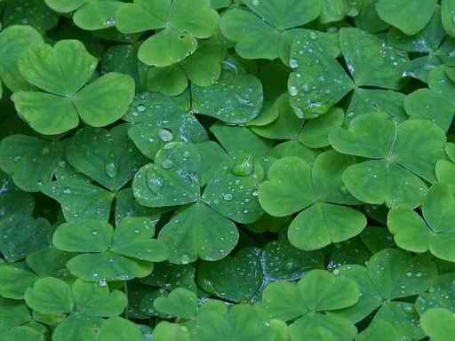
Danny Boy is Londonderry Air
By: Nicholas Pell
“Written by angels.”
-Elvis Presley
“Hauntingly beautiful.”
“Rescued from oblivion.”
- Coleman
Political intentions?

Slide 2
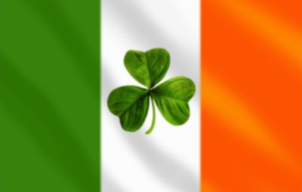
The tune:
“Londonderry Air” (c. 1560-1660)
  Blind harpist named Rory Dall O’Cahan
    Confiscation of family lands and fairy dream by the riverside gave rise to birth of tune
“Aislean an Oigfear” (The young man’s dream)
  Most closely resembles modern “Danny Boy “

Slide 3

The lyrics:
Frederick Whetherly (1848-1929)
  Radio entertainer
  Author of “Danny Boy” lyrics
  Brother-in-law of Margaret Whetherly
    Moved to Colorado during Gold Rush
      Acquired copy of Londonderry Air from Australian worker named Percy Grainger

Slide 4
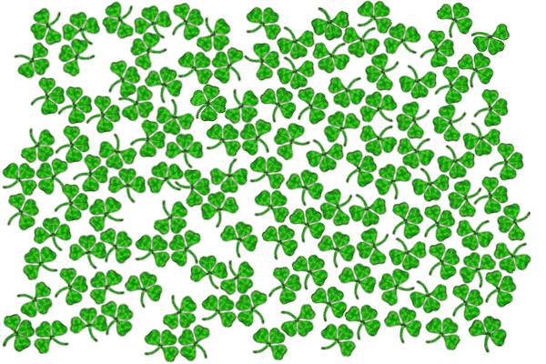

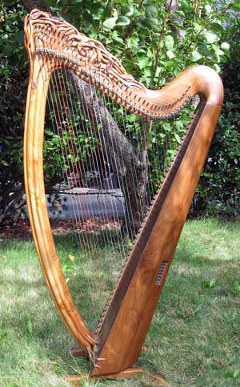
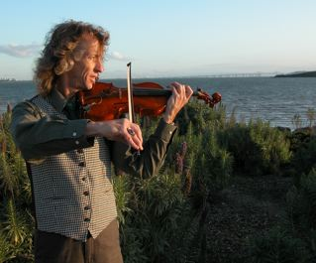
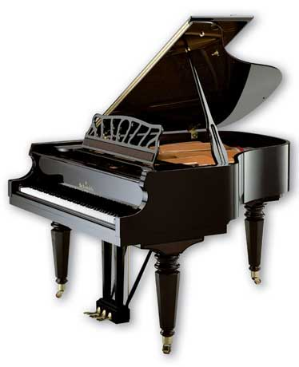
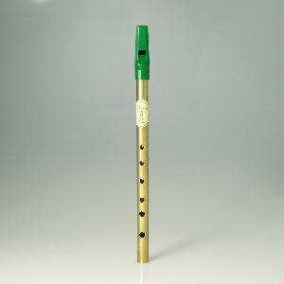
On what:
Harp
Fiddle
Piano
Tin whistle
A cappella
Gavan Ring

Slide 5
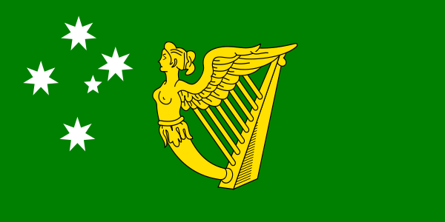
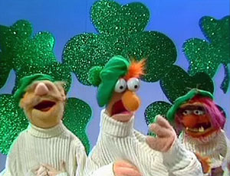
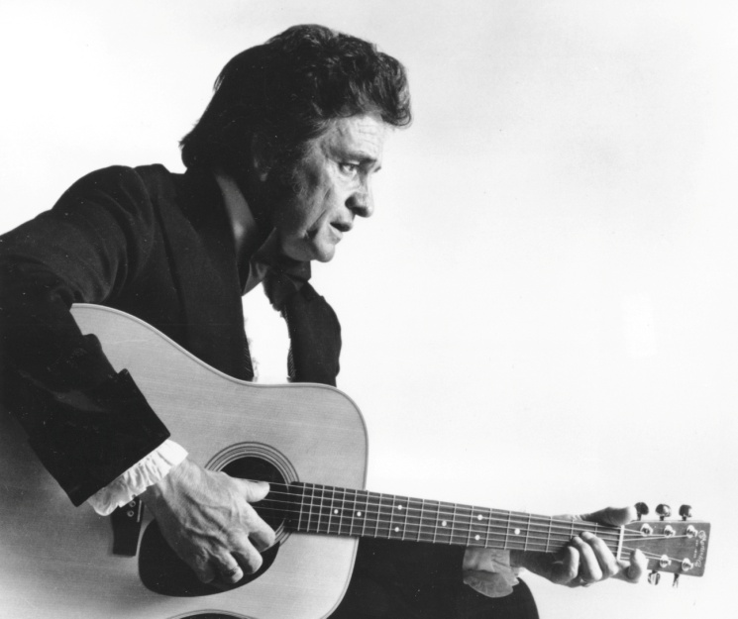
Modern examples:
Category “C”
Category “M”
  http://www.youtube.com/watch?v=OCbuRA_D3KU
  http://www.youtube.com/watch?v=SqbH-bOTa38

Slide 6
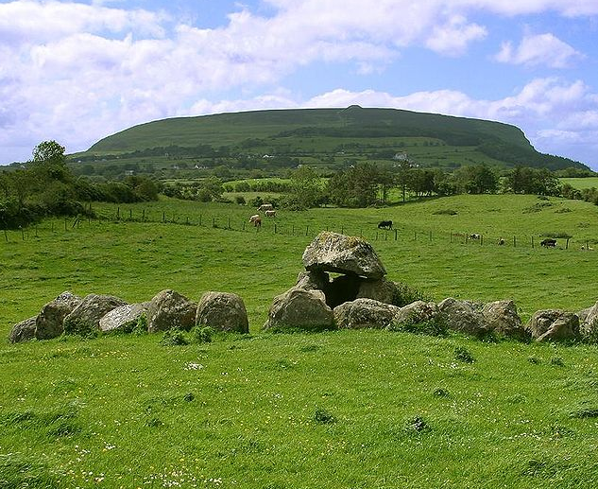
What for:
The meaning of and story behind “Londonderry Air” is very controversial
  Eldest son off to war
    Drafted by Irish Republican Army (IRA)
    Maybe Quèbec or India for British army (specifics not provided)
    Not a note of bloodshed or rebellion
  Off to the “New World” because of Irish Potato Famine (1845)
    Never to return to Ireland, the homeland.

Slide 7
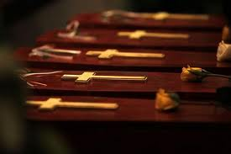
Left in your WAKE:
“Danny Boy” is a very popular funeral song
  Lamenting
  Dreary
  Aspiration for future reunion
  Heart-felt
  Inspirational

Slide 8
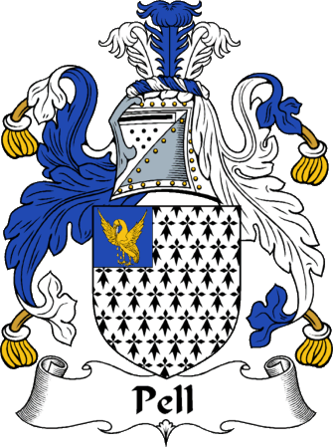
Mine own examples:
Tin whistle
Native American Flute
Harmonica

Slide 9
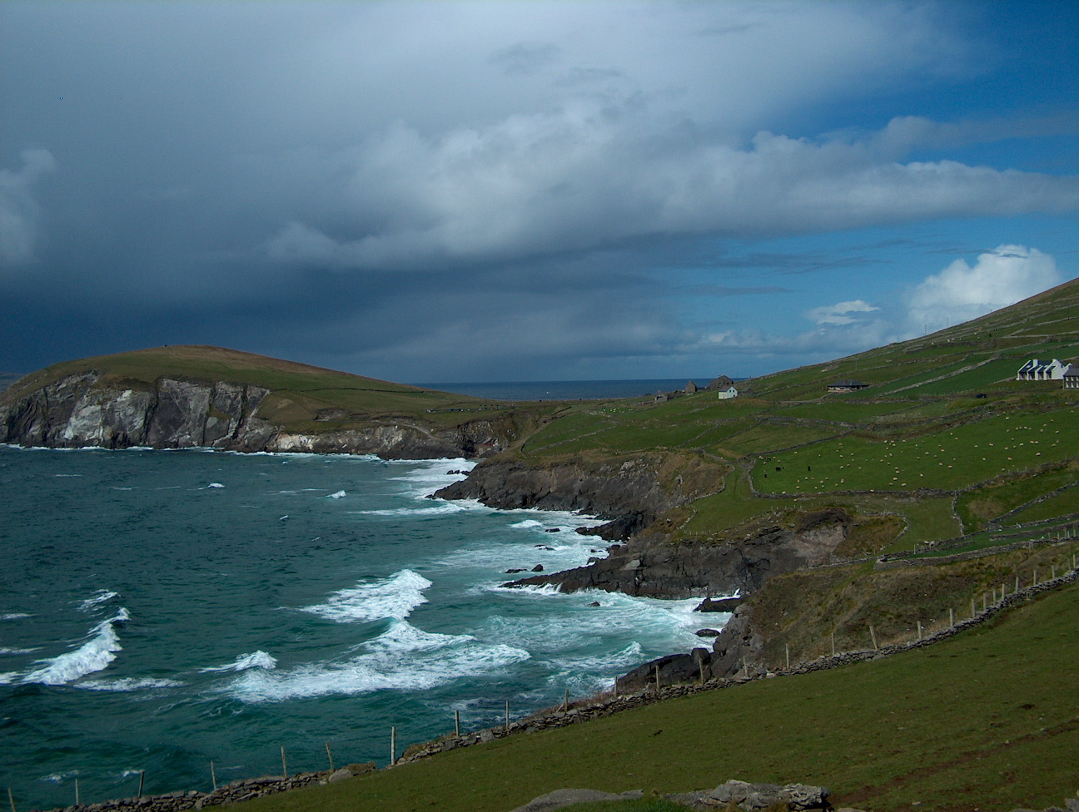
Bibliography
PDF FROM JSTOR:
1.) “Londonderry Air” by Coleman, Henry
http://www.jstor.org.dbprox.slcc.edu/stable/908886?&Search=yes&searchText=Londonderry&searchText=Air&list=hide&searchUri=%2Faction%2FdoBasicSearch%3FQuery%3DLondonderry%2BAir%26gw%3Djtx%26acc%3Don%26prq%3DDanny%2BBoy%26Search%3DSearch%26hp%3D25%26wc%3Don&prevSearch=&item=3&ttl=2550&returnArticleService=showFullText
2.) “The Provenance of the ‘Londonderry Air.’”
http://www.jstor.org.dbprox.slcc.edu/stable/3250670?seq=2&Search=yes&searchText=Londonderry&searchText=Air&list=hide&searchUri=%2Faction%2FdoBasicSearch%3FQuery%3DLondonderry%2BAir%26gw%3Djtx%26acc%3Don%26prq%3DDanny%2BBoy%26Search%3DSearch%26hp%3D25%26wc%3Don&prevSearch=&item=1&ttl=2550&returnArticleService=showFullText&resultsServiceName=null
VIDEOS:
Muppets’ “Danny Boy”
  http://www.youtube.com/watch?v=OCbuRA_D3KU
Johnny Cash’s “Danny Boy”
  http://www.youtube.com/watch?v=SqbH-bOTa38
WEBSITE:
Legend and History of the song “Danny Boy”
  http://h2g2.com/dna/h2g2/A3826136

